Slide 1
CODE FOR GOOD CARE WORKS FOUNDATION
DONE BY-
SULOCHANA ROY(TEAM LEADER)
GAURAV KUMAR
SURBHI JAIN
NAMITHA PADMANABHAN
RAKESH SS

Slide 2
ACKNOWLEDGEMENT
We would like to thank all the employees of JP MORGAN CHASE AND CO, AND THE OFFICIALS FROM THE NON-PROFIT ORGANIZATIONS WHO ACTIVELY PARTICIPATED IN THE CODE FOR GOOD CONTEST TO ASSIST US DURING THE TIMES OF OUR NEED AND ENCOURAGE US AT EACH STAGE TO BUILD AN EVEN BETTER SOLUTION FOR THE PROBLEM STATEMENT GIVEN TO US BY THE NGO’S TO ASSIST IN COMMUNITY SERVICE IN RETURN .

Slide 3
INTRODUCTION Careworks Foundation(CWF) is a non-profit organization established in Jan 2014, that works towards changing the lives of the common mass and thereby creating a better future for them in this endeavor. Driven by the belief that education and health are the two major pillars to accelerate growth in a society, CWF identified several smaller elements under these to encourage community development. Thus they started surveying schools across the country and tried identifying the ones that are performing far below their potential, in order to transform them into a more well-functioning and modern institution with their extended support.
CURRENT PROCESS
Operatives visit schools and collect survey data onto paper forms , that are further transferred to an excel sheet, which leads to the duplication of effort.
Then using the filled assessment form , the action plan is developed for the accepted schools which helps them identify the areas in which they shall be able to assist by intervention.
Finally a report is generated by the organization , after gathering feedback and consensus from the mass.
This process is currently the biggest impediment to the foundation’s plans of scaling to their desired level.

Slide 4
PROBLEM STATEMENT The requirement majorly involved the development of an application that would facilitate the collection of data , required for the conduction of the ‘Need Assessment’ event held in different government schools. Based on the ‘Need Assessment’ performed by the field officers, the decision needs to be made by the program team, whether to accept or reject a project. Once a project is accepted, the application should allow the Foundation to add, view and track each individual activity within a project, with the help of the Action Plan.
KEY POINTERS
Should provide a straightforward interface to the field workers and volunteers, that works fine even in an offline mode, i.e. Without an internet connectivity.
Should provide an administrator interface for administrators to view and edit data.
Possess the ability to generate management reports of all or some data in each project or a comparison between projects, including a visual representation of the foundation’s good works.
Should contain an action planning board for every project that helps the foundation to add, view, or track individual tasks to completion.

Slide 5
TECHNOLOGY USED
BOOTSTRAP
HTML5- CSS3
Bootstrap and HTML5 –CSS3 was used to develop the web application that would be used by the program team or the admin in deciding the action plan after proper scrutiny of the filled in need assessment form by the field workers and volunteers of the organization.
ANDROID
Android Studio 3.1.3 was used to develop the Android application on the mobile phone that could be used by the field workers and the volunteers of the organization to record the response to the fields in the need assessment form.
AMAZON EC2 SERVER- Was used for hosting our files and database to the server.
FILEZILLA- This was used to upload the files containing data onto the server.
XAMPP- This was used to access phpmyadmin and thereby make use of MySQL database.
SQLite- This was used for locally storing the data, collected during the field survey, on the mobile phone that had the application installed on it.

Slide 6
PROBLEM SOLUTION
The solution provided here comprises of an Android application, that locally stores the data collected during the need assessment survey, on the mobile phone using SQLite database.
This not only helps us to store the immediate responses from the school authorities by the field managers, but also helps us store the data technically and not manually, thereby reducing the duplication of effort as was prevalent earlier.
Now once provided with an internet connection, this locally stored data gets uploaded onto the Amazon EC2 server, from where it is further navigated to the web application, that is developed to be accessed by the administrator or the program team of the organization;

Slide 7
PROBLEM SOLUTION
This web application enables the administrator or the program team of the organization to primarily decide whether they would like to accept or reject a certain project, based on the responses recorded to the need assessment form.
Furthermore after the acceptance of a project by the administrator, action plan is designed for successful implementation of the project.
If the needs of the institution are found to be inadequate , then the project is rejected by the administrator based on the responses recorded to the need assessment form.
Finally after taking review from the stakeholders and other concerned personnel of the organization, and depending upon the past and current data set, post the completion of the project, a management report is made comprising of bar graphs and presented before the schools, that depict the level of the progress after a particular project was undertaken by the non-profit organization in order to transform the institution to a higher level.

Slide 8
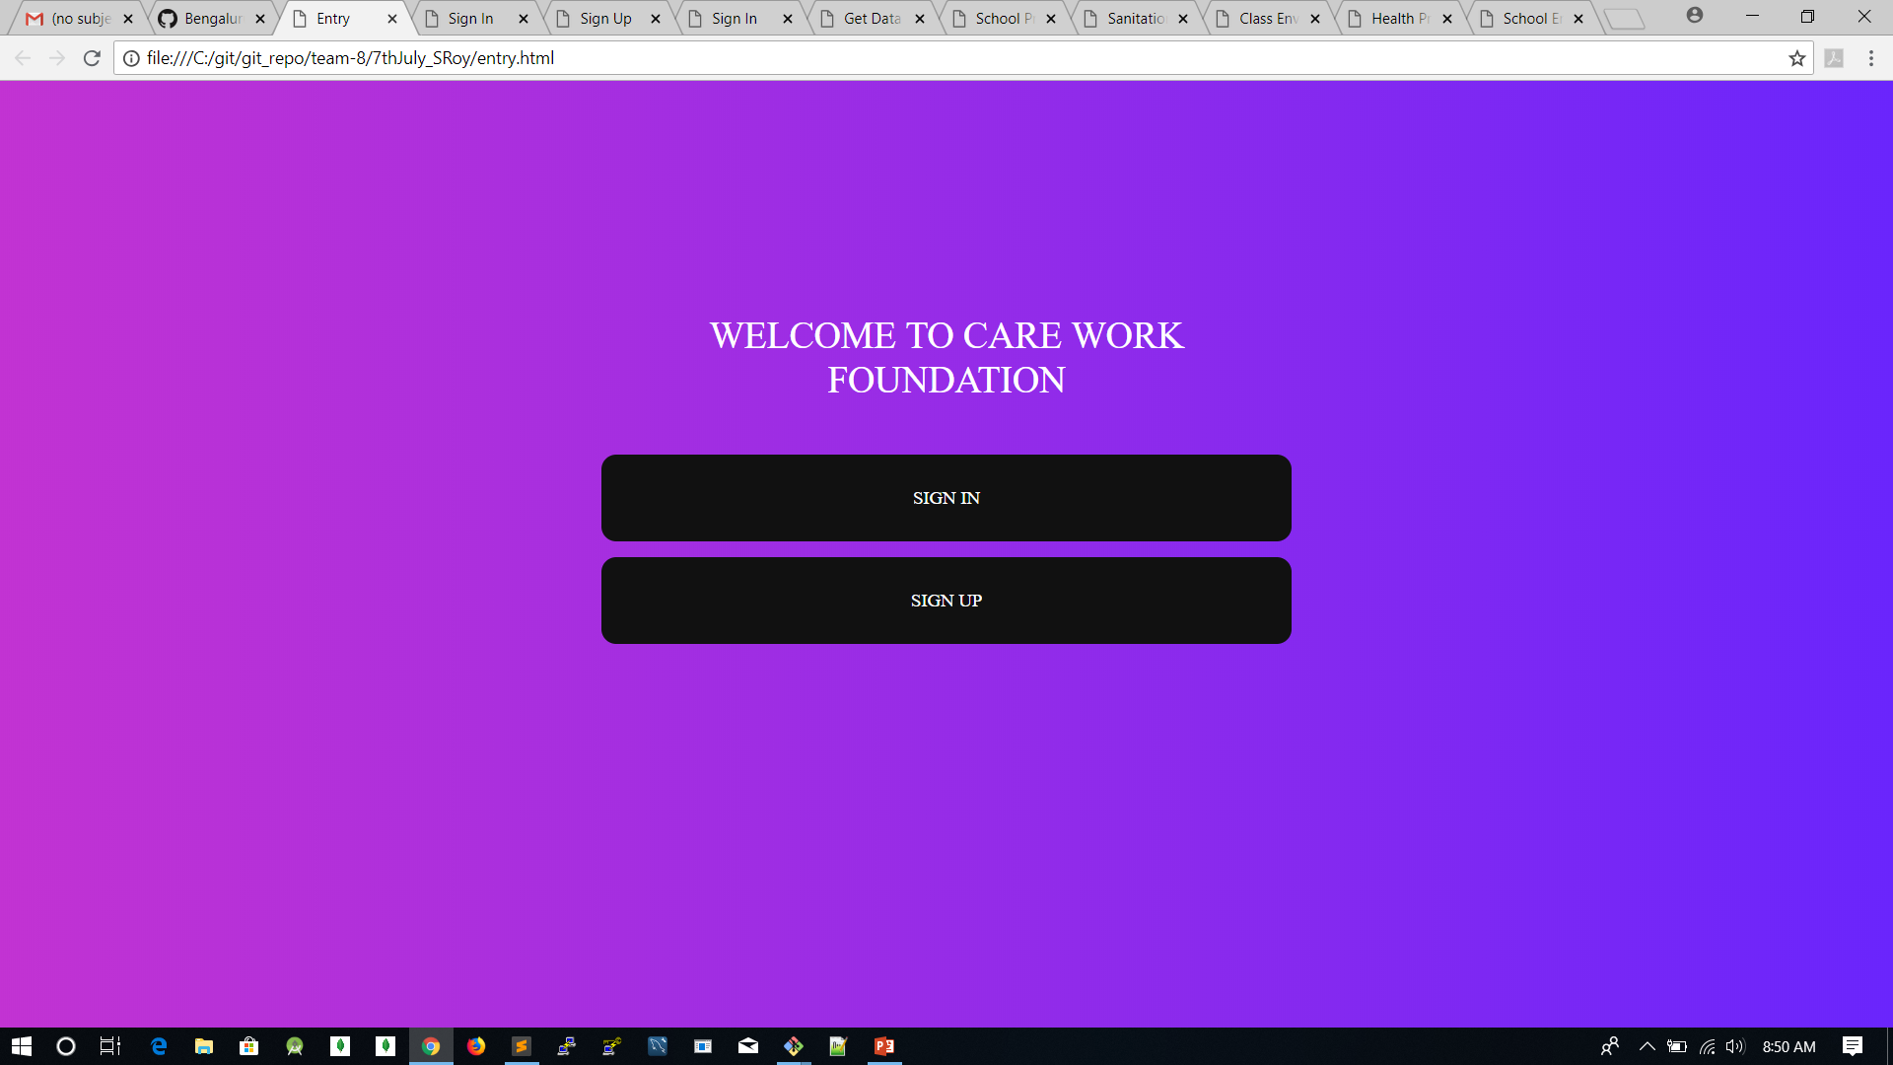
SCREENSHOTS OF THE WEB APPLICATION

Slide 9
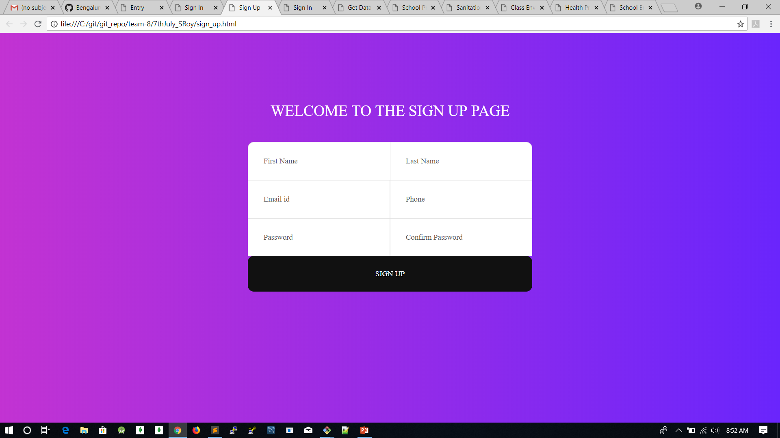
SIGN UP PAGE

Slide 10
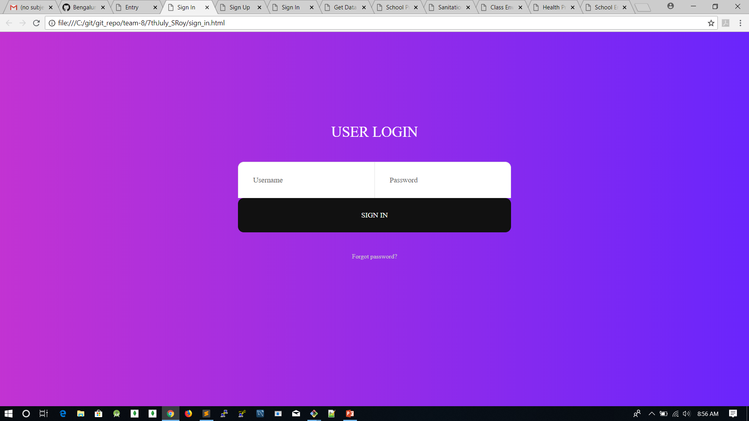
SIGN IN PAGE

Slide 11
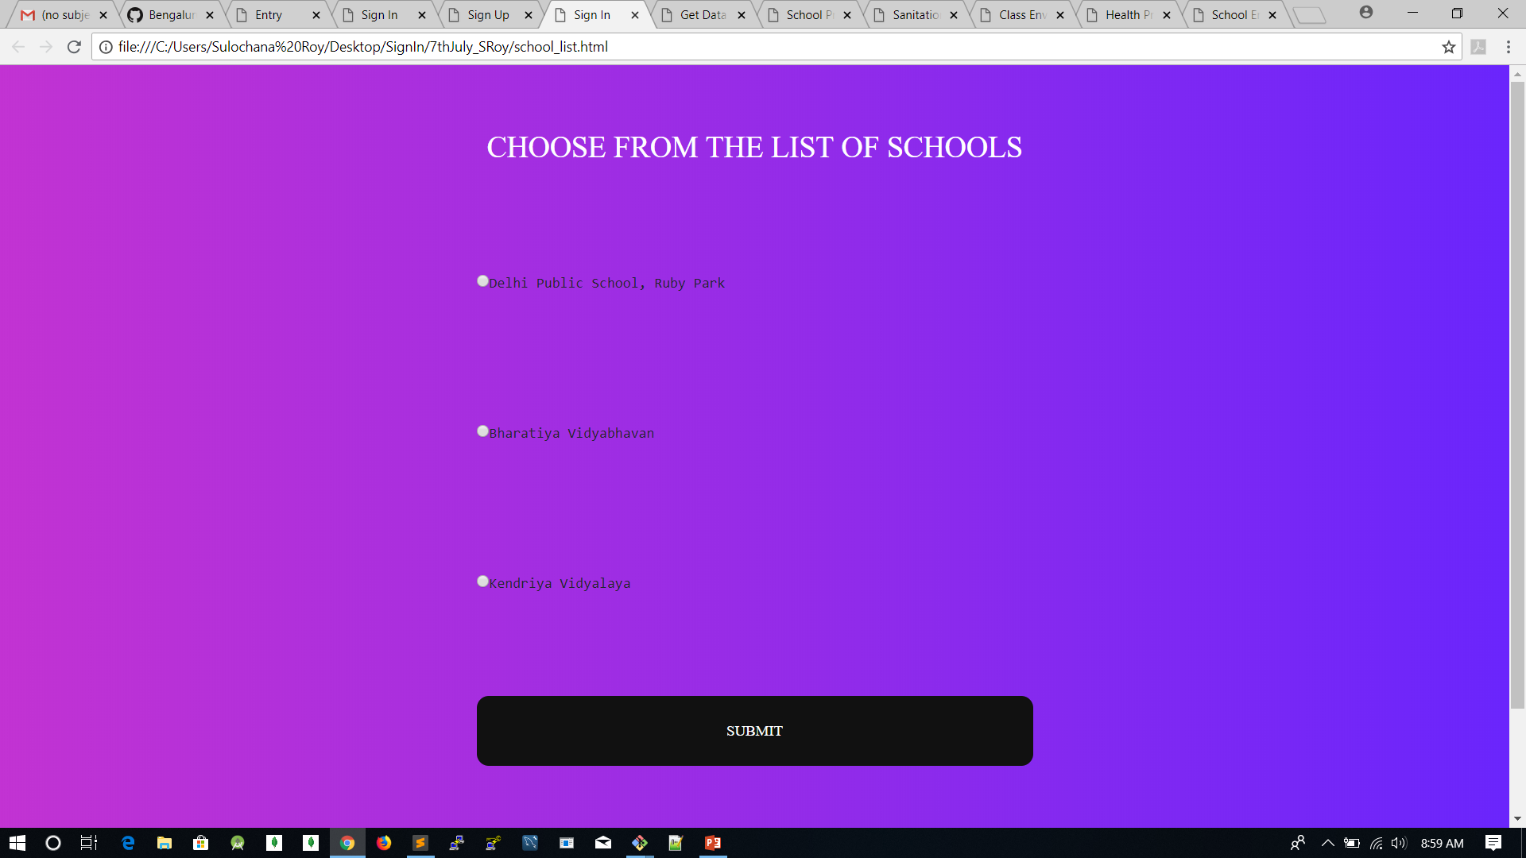
LIST OF SCHOOLS PAGE

Slide 12
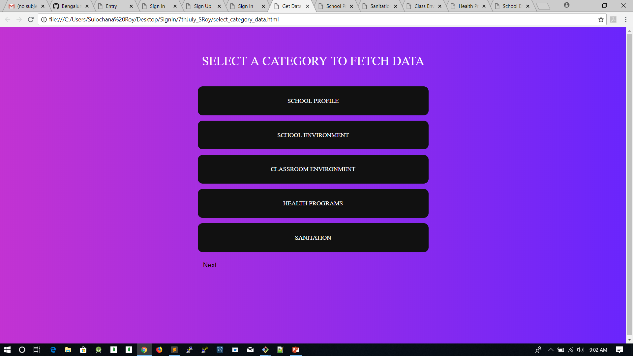
CATEGORIES OF DATA

Slide 13
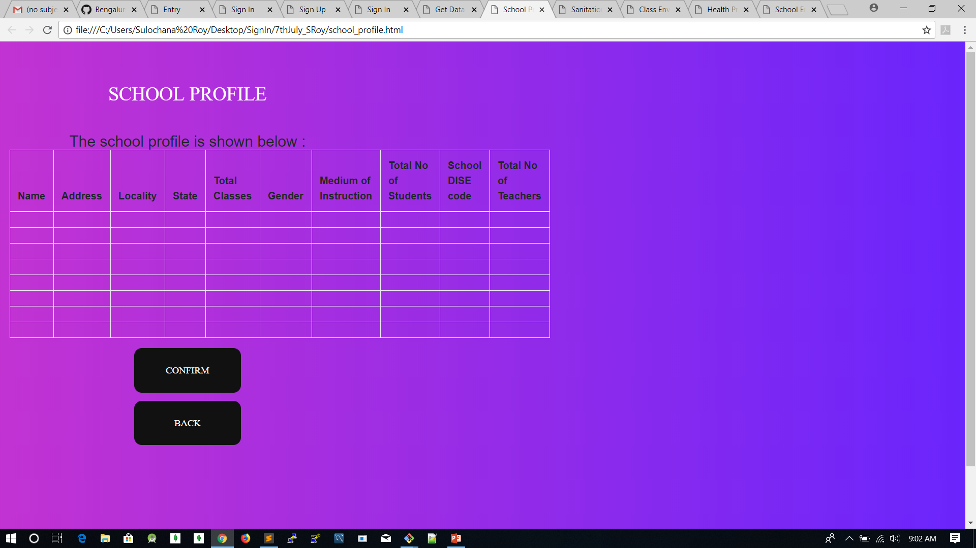
SCHOOL PROFILE

Slide 14
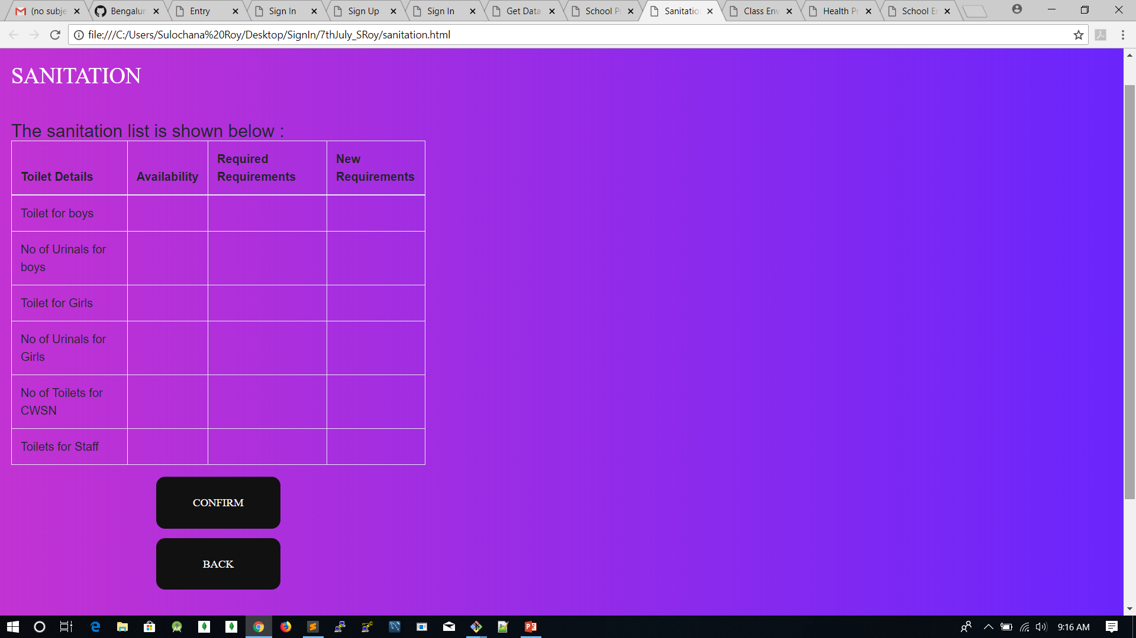
SANITATION

Slide 15
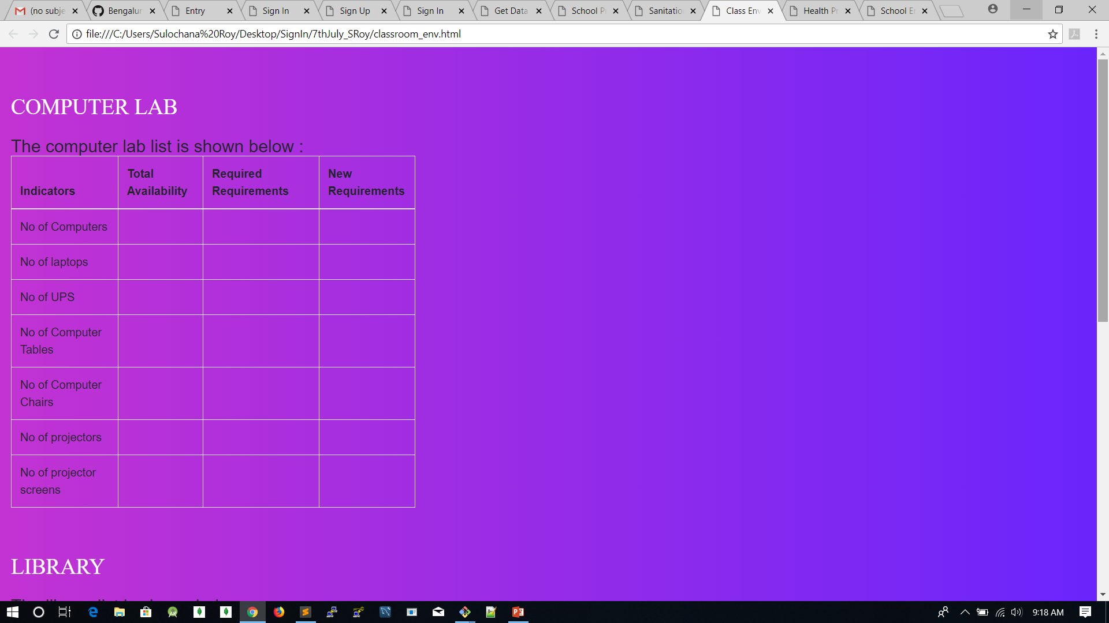
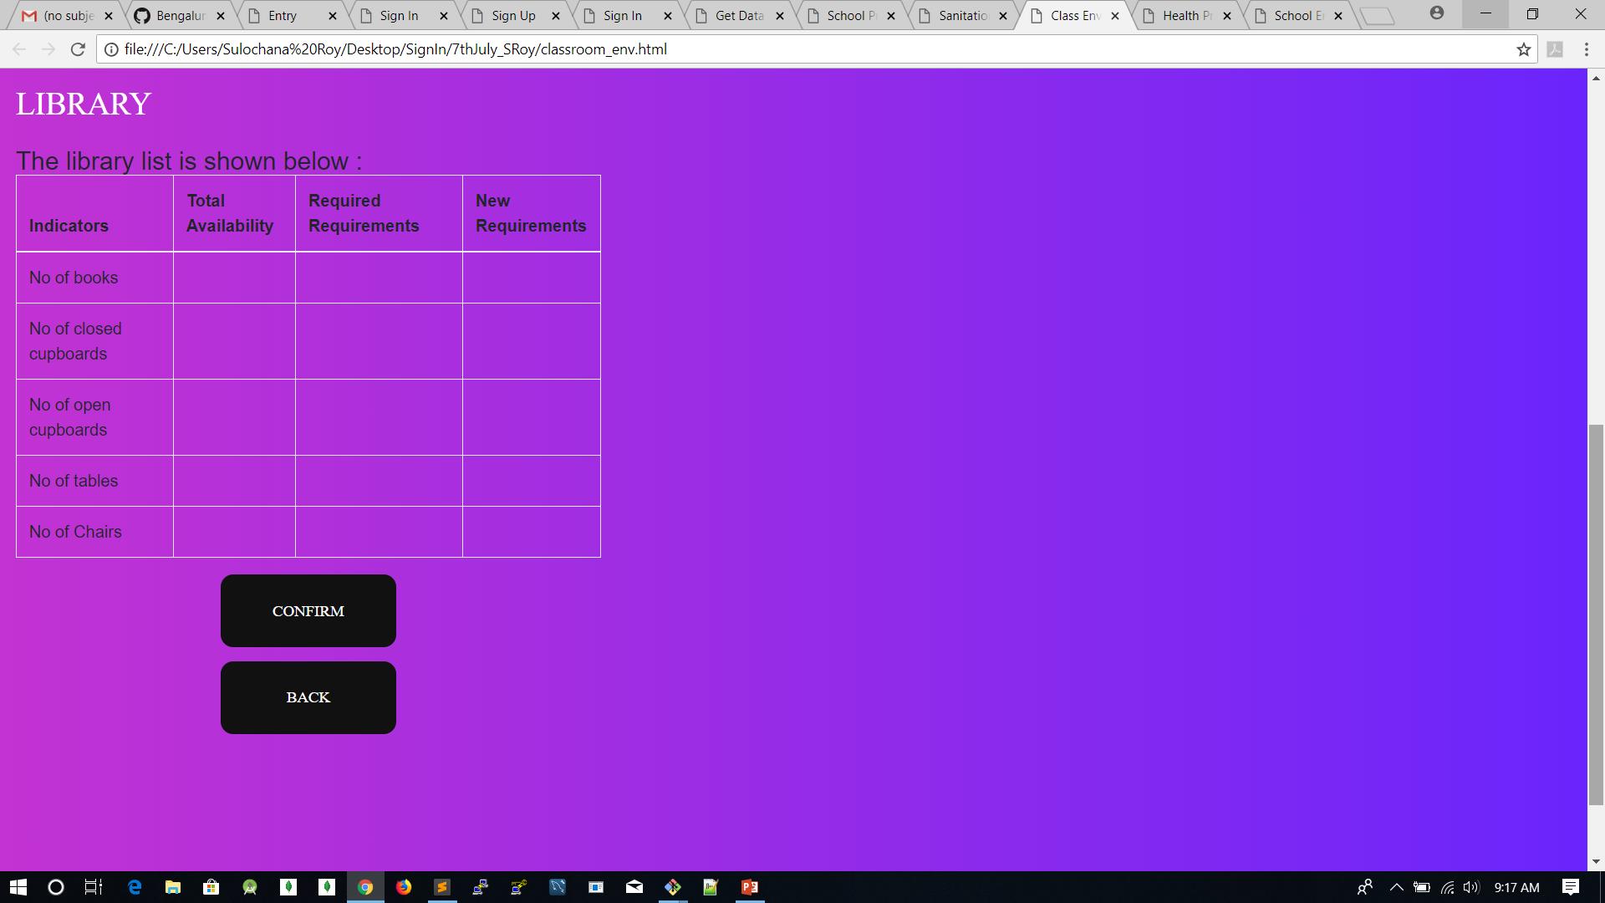
CLASS ENVIRONMENT

Slide 16
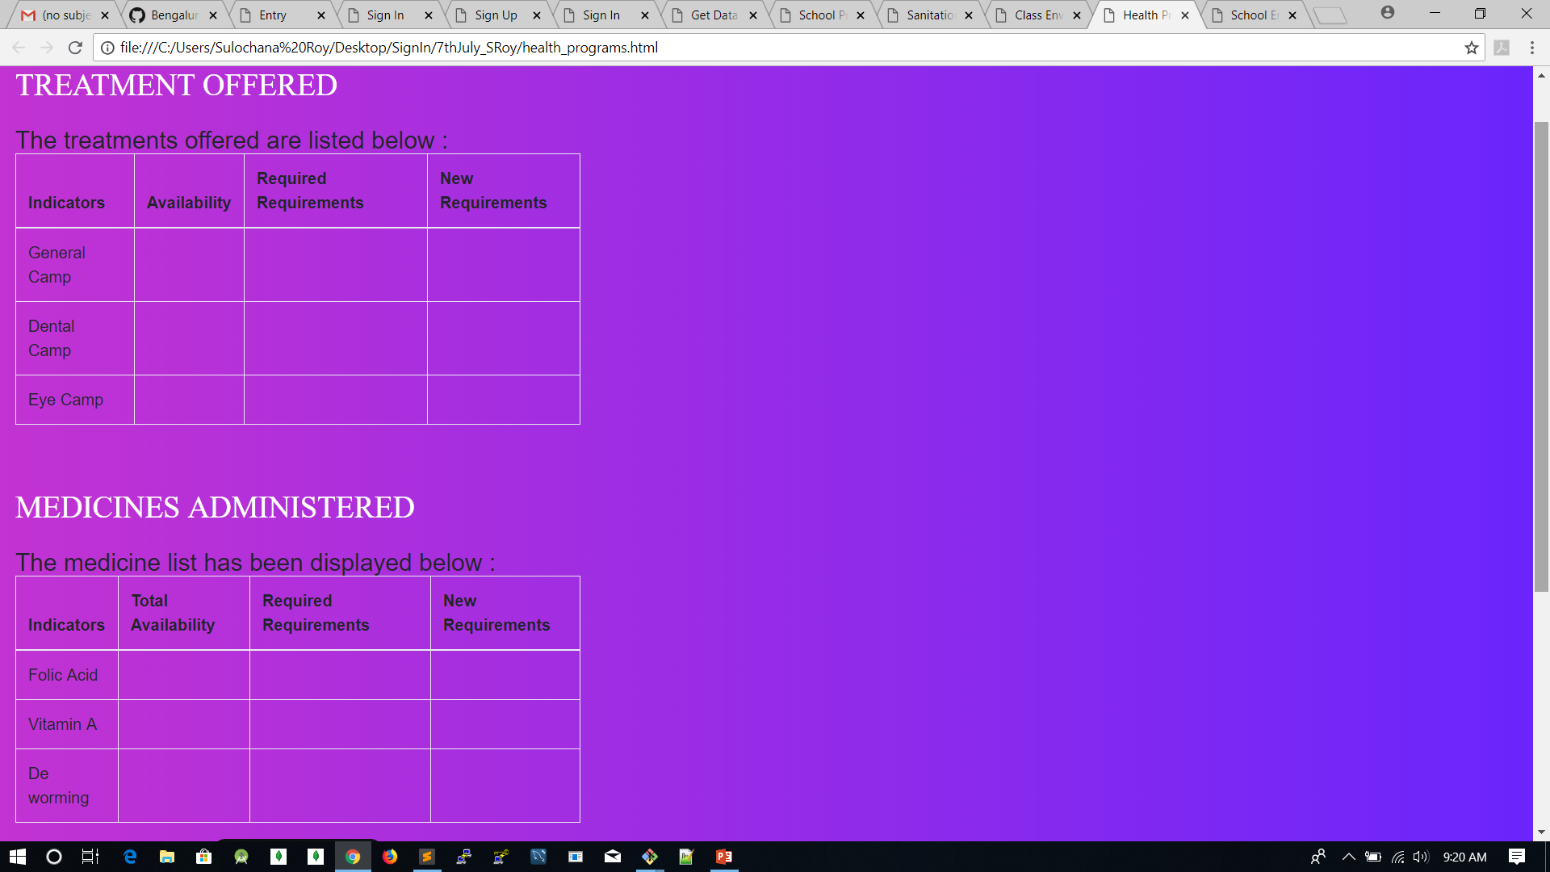
HEALTH PROGRAMS

Slide 17
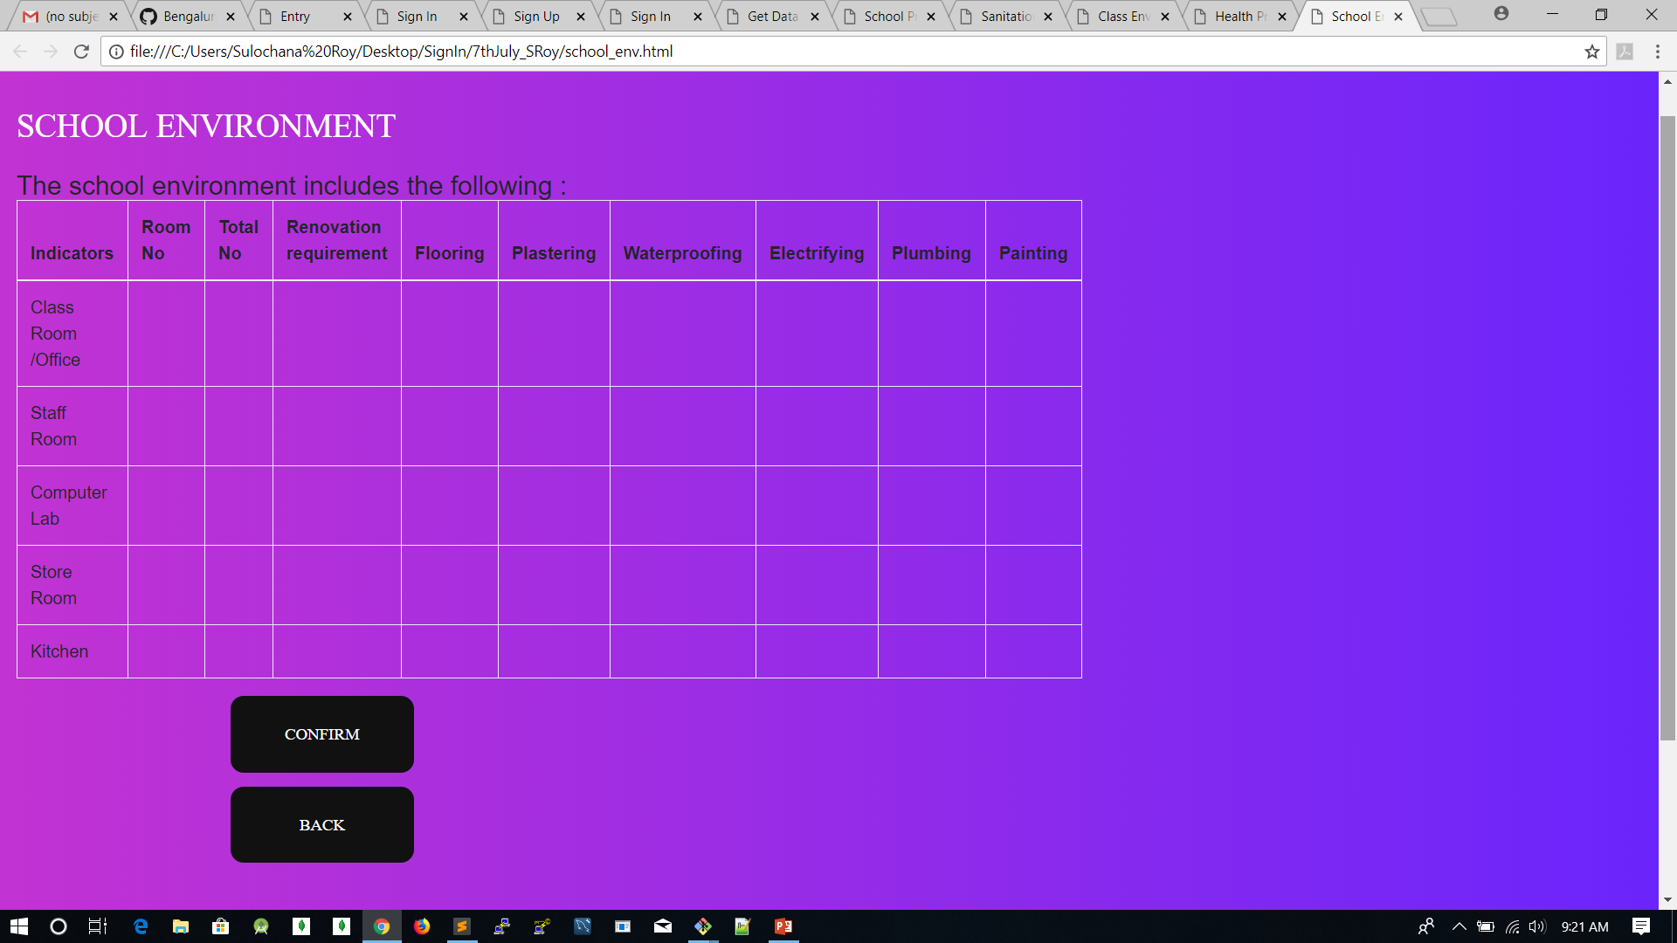
SCHOOL ENVIRONMENT

Slide 18
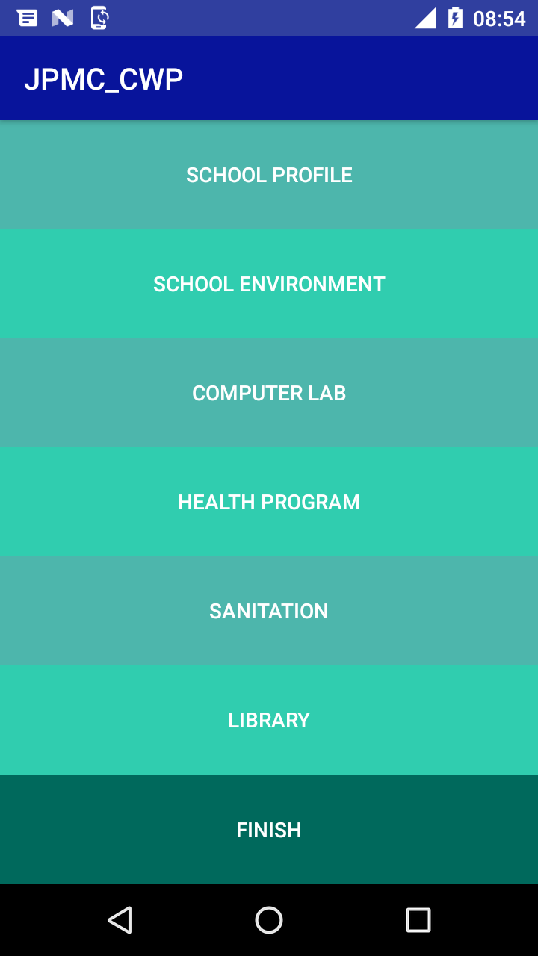
ANDROID APPLICATION
HOMESCREEN

Slide 19
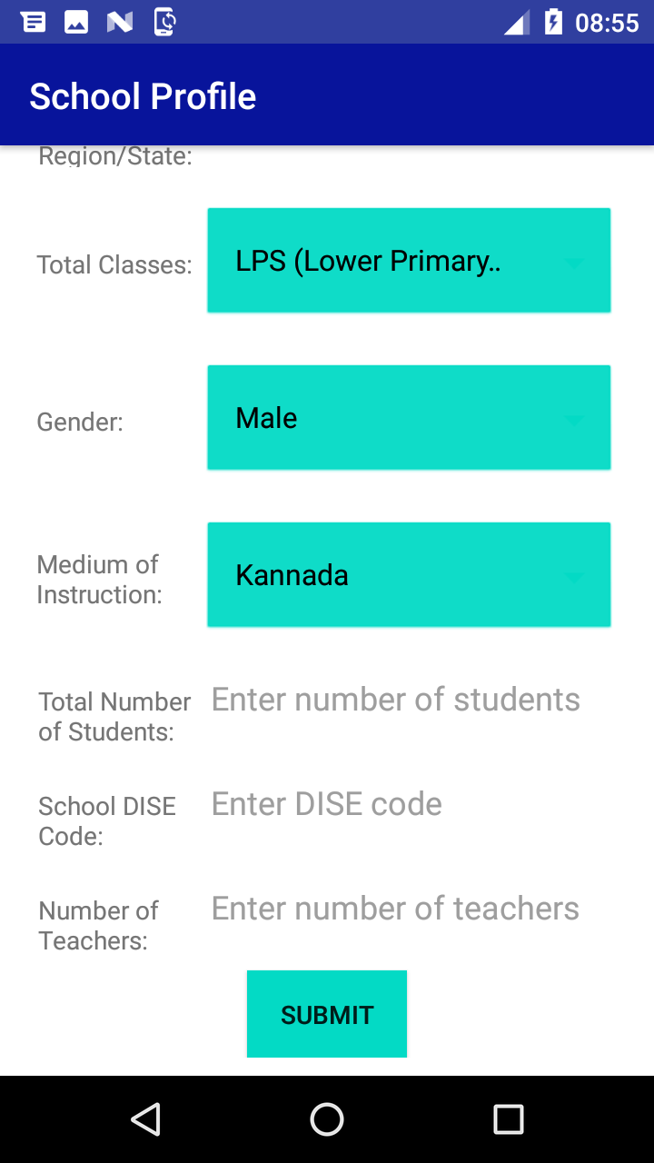
SCHOOL PROFILE

Slide 20
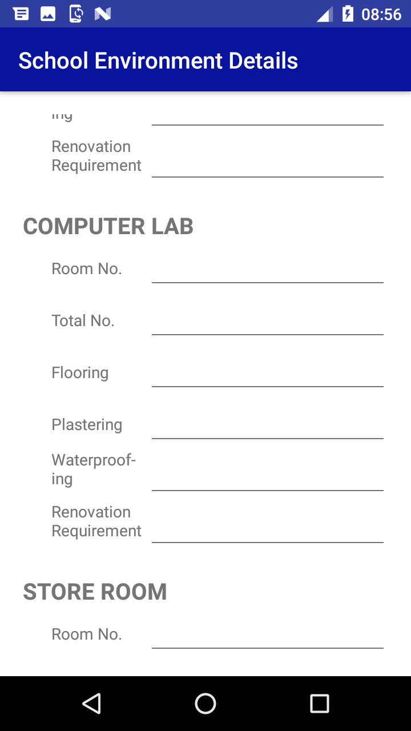
SCHOOL ENVIRONMENT

Slide 21
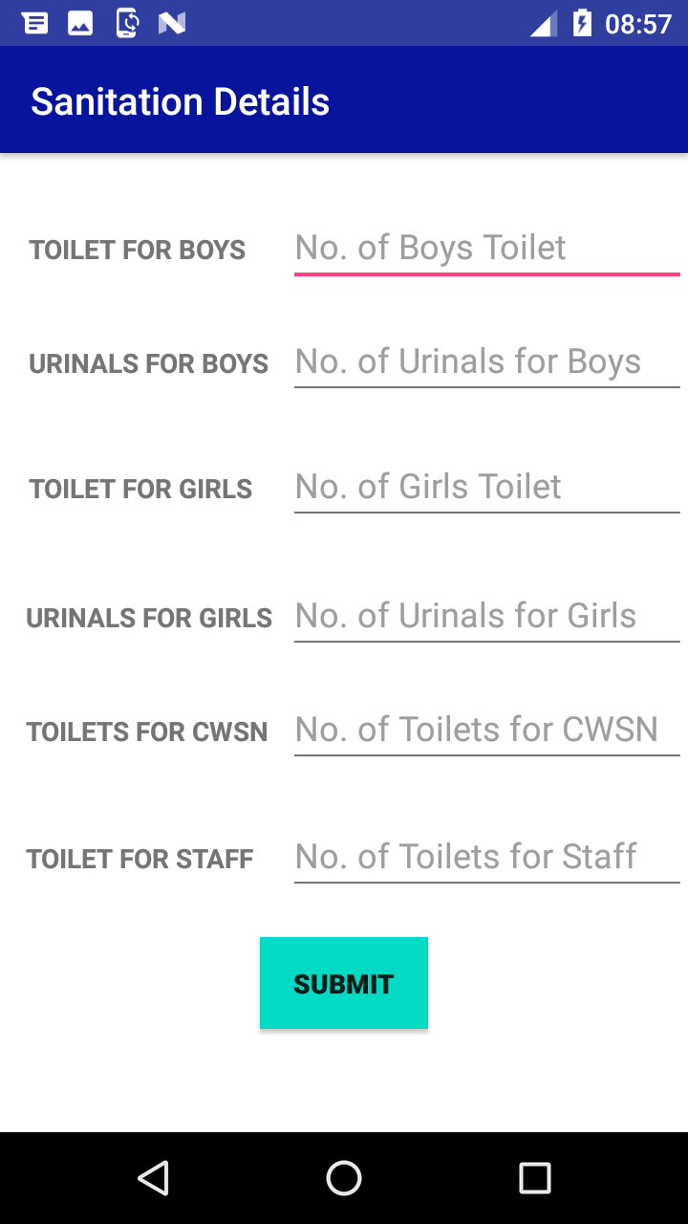
SANITATION

Slide 22
THANK YOU….!

